Slide 1

The Coach Model
Applying the COACH Model in Children Ministry

Slide 2



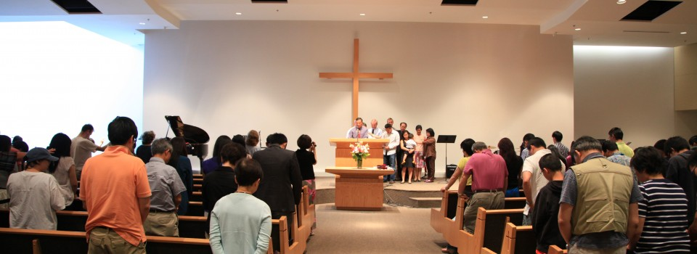
Notes:
Give an brief introduction about myself so that the participants can understand my perspective.
It is intended to help participants get a sense of where I am “coming from” and not just a random “joe” speaking to them.
I worship and serve at the Vancouver Chinese Evangelical Free Church, and I have served the children and teens there for close to 13 years now. For the past two years. I am the children/youth ministry intern, and I am completing my Master of Divinity at ACTS Seminaries (TWU). My ministries include Awana, VBS/Camps and Highschool Youth Group. I also enjoy preaching occasionally at my church.

Slide 3

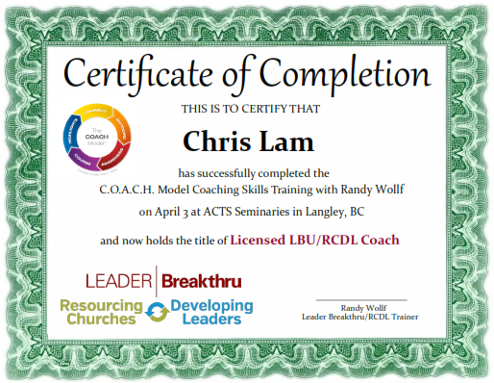
Notes:
Give an brief introduction about myself so that the participants can understand my perspective.
It is intended to help participants get a sense of where I am “coming from” and not just a random “joe” speaking to them.
I enjoy serving with my team of leaders, and last year, Dr. Randy Wollf introduced and trained a class of seminary students using the Leader Breakthru COACH Model. I personally found that the COACH model fits very well with children/teens ministry, and I have seen been adapting this into my own ministry context.

Slide 4

Goals/Objectives
know the difference between coaching and mentoring
“Practice” Listening and Expanding
begin your own development as leader coaches
explore applications of the COACH Model in children ministry
Notes:
Share today’s goals/agenda with the participants, use this as a guide for the rest of the discussions.
With today’s session:
I want to introduce you to coaching (based on the COACH Model)
I will give you an overview of the model, and since we have limited time, we will focus on one or (hopefully) two skills that will help you apply this model
Spark your interest in pursuing additional coaching training
Apply/adapt the COACH model in your own ministry setting.

Slide 5

Mentoring vs Coaching?
“A mentor goes before and pours in.
A coach stands beside and draws out.”
- Steven Ogne
Notes:
In the past few years, I have noticed a lot of workshops and conferences focusing on mentoring and discipleship. So, what is the difference between coaching and mentoring? Is this just another rebrand of mentoring?
Before we focus on coaching, let’s take a moment to think about mentoring vs coaching.
Question 1: When you hear the word mentoring, mentor, or mentorship, what adjectives come to mind? (2-3 minutes)
Some responses may be: age, wisdom, knowledge, experience, time, relationship, caring, discernment…
Question 2: When you hear the word coaching or coach, what sort of adjectives come to mind? (2-3 minutes)
Some responses may be: football coach, tough, wise, know the game, knowledge, time, relationship….
Here’s a quote that I find quite accurate in distinguishing between the two…
“A mentor goes before and pours in. A coach stands beside and draws out.” – Steven Ogne

Slide 6

Mentor
Wisdom and discernment
Life and ministry experience
Timely advice
New methods
Skills
Principles
Important values and lessons
Organizational influence
Financial resources
Notes:
Mentoring is a relational experience in which one person empowers another by sharing God-given resources
Mentoring makes the mentor’s personal strengths, resources, abilities, and networks available to help a protégé reach his or her goals.
Mentoring is about guiding and teaching. When a protégé faces difficulties in life or ministry, a mentor provides insight and guides him/her through different ordeals and challenges.
A mentor can pour in a variety of resources…refer to list in slide.

Slide 7

http://www.dexmedia.com/media/time-for-answers.jpg
Notes:
This is purely my observation, so please correct me if I am wrong…
What I notice with mentoring, is that often times a person goes to their mentor when they need help or need answers. And…often mentors give answers/advice. This is helpful in some scenarios, but for someone to learn, it helps if they were actively involved in the problem solving process.
Something I didn’t mention during my brief introduction, because I wanted to keep it brief, is that my wife and I are both practicing teachers. She specializes in elementary, and I am a high school science teacher.
Are there any teachers in the room right now? Anyways, whenever students goes to a teacher looking for answers, there are a few things a teacher can do:
Give them the answer or the answer key
Point out the page number in the text where the info can be found
Ask them more questions to help them think.
From previous experience in a classroom, I can tell you that most students want 1. Get answers right away…but what I found, and if there are any teachers in the room right now feel free to disagree….is that they don’t really remember what you tell them once they write it down. This is because they never went through the problem solving process…

Slide 8

Coach
Discovery
Change
Action
Notes:
Coaching is about discovery – rather than teaching. The individual being coached is the expert on his or her own life.
Coaching is about all of the leader as a person, not just the skills, knowledge or resources needed to be successful.
Coaching is also about change, and confronting habits and thought patterns that are often deeply imbedded over the years, and are difficult to alter, requiring ongoing and consistent effort over time.
Coaching is about action – taking action steps…
Look at the picture for a second, who do you think is the coach in this picture?
- I would say that the coachee (the one being coached) is the one pointing at the target. (the one on the left). Coaching is about drawing out goals from the coachee and helping them determine steps to meet their target.

Slide 9
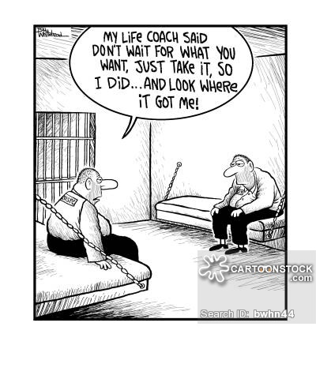
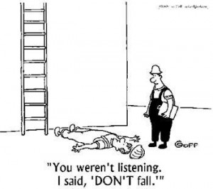
Notes:
Some comics showing “funny bad coaching”

Slide 10
Notes:
Examples of bad mentoring and bad coaching is to put into context that…
Mentoring and coaching are all tools for equipping, and the tools can only be used effectively if the person is trained/equipped to use it.

Slide 11

Proverbs 20:5
The purposes of a man’s heart are deep waters, but a man of understanding draws them out.
Notes:
How many of you have gone diving before? I am not a regular diver…in fact, I haven’t gone diving in a long time. But I remember about 10 years ago when I was on vacation and I went diving with a tour, as you go deeper in the water, visibility starts to decrease because less light is shining through into the water. Although I was able to see, I was not able to see very far, and there are some things, some details, that I would miss.
SO this verse, Proverbs 20:5, compares a man’s heart to deep waters. There are many hidden things, it can be murky, it can be blurry, it is unclear. But, a “man of understanding”…a generic man (man and woman)…can draw out the “purposes” that are hidden in a man’s heart.
This verse serves as two reminders for me:
Everyone has a purpose, or purposes, but it (they) are often hidden and unclear to the person
It takes someone else to help draw out these purposes (a man of understanding).
So…before we continue and look at different aspects of coaching, there is a prerequisite that I must point out.

Slide 12
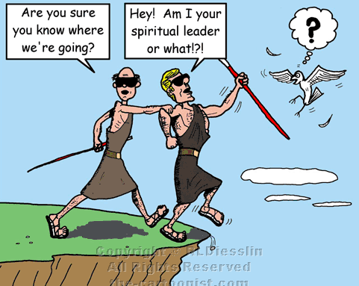
Prerequisites
Love Jesus
“Know” Jesus
  Learning
  PrayINg
  Growing
http://www.the-cartoonist.com/gospel2/30_luke.html
Notes:
In order to be a “man of understanding”, to equip others, or even be a “good” coach, you must:
Love Jesus
Be always learning, a life long learner and reader of the Scriptures
Always praying…for guidance, for wisdom, to hear God’s voice.
Always growing in your relationship with Jesus, growing in your knowledge of God, and growing in your relationship with others
Otherwise…you would be the blind leading the blind…s

Slide 13
Notes:
Let’s get started…
Here is an overview of the 5 elements of the COACH Model. This is based on the book called The COACH Model by Keith Webb.
The five elements include:
Connecting with the leader
Determining the session outcomes
Building awareness of the issues and current reality
Determining the next steps and course of action
Reviewing the highlights and key insights of the session
This method can probably be applied in many different ways. For our workshop today, I am going to focus on how I have started to use this in children ministry as an example/case study, and then at the end, we can discuss other ways we can incorporate this into ministry.
We will explore each element with a bit more depth in the upcoming slides.

Slide 14

Shadow Coaching (Ninja Coaching!)
Notes:
In my ministry setting, I currently use this method to help me connect with leaders on a personal level. I only have 2 formal coaching relationships set up at the moment, but what I use with all the leaders/teachers/counselors I serve with is….
SHADOW COACHING!
I engage the leaders, especially the highschool/college leaders, but ninja coaching them. I find that when they are not aware that they are being coached, they don’t put up walls and they are more likely to keep their guard down. I don’t encourage tricking your leaders into being coached, but I find that by applying these 5 elements into conversations with those you serve with, you can achieve very similar results as formal coaching sessions.
In fact, the two formal coaching relationships I am engaged in right now started with the concept of shadow coaching. Once I connected with them and built to a certain level of trust, I was able to tell them formally to invite them to set up formal coaching with me.

Slide 15

Example Questions
How have you been?
How are things going?
What insights have you had since our last session?
What progress did you make on the action steps you were going take?
Notes:
The first element is:
Connecting with the leader
This is the time when you connect with the coachee and to build trust. Without trust between the coach and the coachee, the coaching process would be much less effective.
As a coach, you would ask questions that allow you:
Get to know the coachee more
Find out about their current struggles
Figure out “victories” that you can celebrate with them
If you have an ongoing coaching relationship, then you can use this time to followup on action steps

Slide 16

Example Questions
What result would you like to take away from our meeting today?
What would you like to work on?
What would make today’s session helpful for you?
Notes:
In Determining the session outcomes:
This is the part where you allow the coachee to take charge of your time together. As a coach, your role is to draw out from the coachee; so some questions you can ask could be…(refer to slide).
These questions allow the coachee to think about some things that they want to work on, and as a coach, these are things you would have to remember (take notes of) and then reference them throughout your time with the coachee.

Slide 17

Example Questions
Talk to me about what you are thinking.
What do you see to be some of your major obstacles?
What are the factors that you have bumped up against in the past?
Let’s look at this from a different perspective: what else could be happening?
What would be some additional options you might want to consider?
Notes:
For Building awareness of the issues and current reality:
As a coach, you would need to be intentional about drawing out the specifics from your coachee. This can be done by asking questions that expand on the issues they have raised in the outcomes step.
Again, it is important to refrain from giving advice, but listen and ask questions to help draw out from the coachee. You want him/her to take an active part about addressing this (these) problems/struggles/challenges

Slide 18

Example Questions
What actions would you like to take to move forward?
What options do you think do you think most address what you want to achieve?
Which of these would you like to do? How? When?
What questions do you want me to ask you next time we are together, to help hold you accountable?
Notes:
Determining the next steps and course of action:
This is the step where the coach help the coachee figure out a course of action
We are talking about BABY STEPS!
Small, focused action steps allow the coachee to achieve their goals
You can celebrate these little victories with them each time you meet with them in the “connect” stage

Slide 19
Example Questions
What would you like to remember from this time?
What parts of the discussion were particularly helpful?
Based on your discoveries today, what are your action steps?
Notes:
Reviewing the highlights and key insights of the session:
This stage enable the coach to find out how the coachee would like to kept accountable
By getting the coachee to articulate some of the things they shared about during your coaching session, it allows them time to process and think about their next steps

Slide 20
Four Coaching
Skills
Listening
Expanding
Focusing
Empowering
Notes:
There are four essential coaching skills that allow a coach to implement the COACH Model more effectively.
These are: listening, expanding, focusing, and empowering. Because we have limited time in our session today, we will not be able to go through all of them. Based on my observations from applying this in ministry, I have narrowed these four skills down to TWO essential ones: Listening and Expanding, and we will practice these today.
These are skills that were taught in the Mentoring/Coaching track by Dr. Wollf at this conference, so if anything here sparks your interest, feel free to either access the recordings of his sessions online, or better yet, register for the next MinistryLift Conference or contact Dr. Wollf about training opportunities.

Slide 21
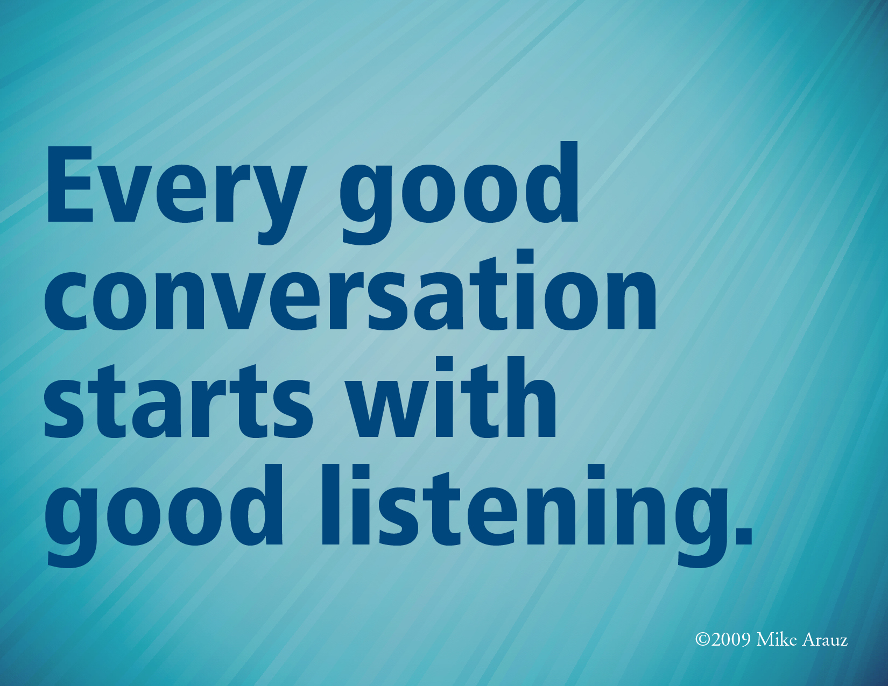
con·ver·sa·tion
noun \ˌkän-vər-ˈsā-shən\
oral exchange of sentiments, observations, opinions, or ideas
"Conversation." Merriam-Webster.com. Merriam-Webster, n.d. Web. 21 Oct. 2014. <http://www.merriam-webster.com/dictionary/conversation>.
Notes:
Coaching is about conversations. It is a dialogue that draws out clarity in a coachee’s life.
Merriam Webster defines conversation as an oral exchange of sentiments, observations, opinions, or ideas.
It is an EXCHANGE, which means one talks, the other listens. As a coach, your responsibility is to focus on the listening component of a conversation.
Let’s try do an exercise!

Slide 22

Notes:
On the next slide are photos showing some emotions.
Let’s identify the emotions showing in each one.

Slide 23


Slide 24
Notes:
The next three slides each include one photograph each.
In partners or groups of 3s, “listen” to the situation, the behavior, and the emotions of each of these images.
Take 1 minute to “listen” to each image
Share
Consensus?

Slide 25

Case #1
The Situation:
_____________________
The Behaviour:
_____________________
The Emotions:
_____________________

Slide 26
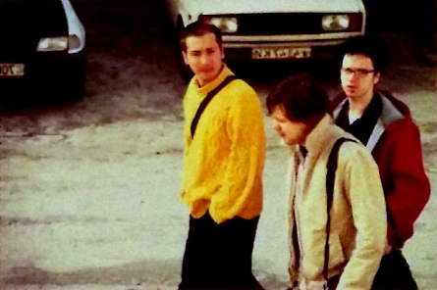
Case #2
The Situation:
_____________________
The Behaviour:
_____________________
The Emotions:
_____________________

Slide 27

Case #3
The Situation:
_____________________
The Behaviour:
_____________________
The Emotions:
_____________________

Slide 28

Notes:
Why do you think we “listened” to these images differently?
Lenses! We all have different lenses and filters that modifies what we see and hear just enough that we pick up different visual queues.
When we listen, we actually listen with our eyes to pick up different visual cues!

Slide 29

Listening
Their Behavior
  Sounds like things are good…Any major challenges lately?
  Things appear to be challenging right now. Is that what I am hearing?
  These new issues seem to be taking a lot of your time…is that true?
Their situation
  How are things going at home?
  What’s been going on since we last talked?
  Get me up to speed…
Their Emotions
  So, how are you?
  How are you doing with self-care at the moment?
  What have you been up against lately?
Notes:
From the exercise, we tried to listen for three things:
Behavior
Situation
Emotions
Go over handout P.1

Slide 30

Expanding
Pure Questions
Neutral or non-judgemental
Provoke greater understanding
“draw out” responses and feelings
Notes:
P.2 of handout.

Slide 31

Example #1
What part does your negative attitude play in this problem?
How is your mindset helping or hindering the problem?
Notes:
The first question can cause the leader to be defensive. A neutral question promotes more reflection and less defensiveness.

Slide 32
Example #2
What options do you see in working with him?
Have you thought about firing him?
Notes:
Suggesting dismissal through the question directs the leader to that being the preferred option…

Slide 33
What don’t you like about your current position?
What’s wrong with our program?
I don’t think that will ever work, do you?
I know from my experience that will not work.
I don’t think your current approach is working. What do you want to try next?
No wonder she is mad at you. What did you expect?
So why didn’t you try that in the first place?
Notes:
In groups of 3 or 4, reword these questions, share your “revisions”. See if as a group you can come up with some great revisions!
These are found on the You Try It from page 3 of handout.
Summarize this activity: Page 4 of handout. Seven Types of Questions.

Slide 34
Four Coaching
Skills
Listening
Expanding
Notes:
Time to Try!
For the next 10-15 minutes:
Partner with someone (one is the coach, and one is the coachee)
Practice using listening and expanding skills
Begin with the “connect” stage and then see how the conversation naturally proceeds, while keeping in mind the 5 stages
Do not rush it! You do not need to get through all five steps
How “far” did you get along the five stages in 10-15 minutes?
That’s right! It takes a long time to get really draw out during each stage, but as you can see here, different people will take different amounts of time.
To apply this in your ministry setting, remember coaching relationships take time!

Slide 35


